Slide 1
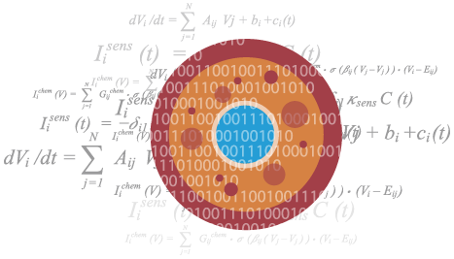
Prerequisites + Intro to Biological Models
June 9, 2019 (Adapted from 2018 slides for UW iGEM) (Using some material from BIOEN 485)

Slide 2
Note: There is an anonymous feedback form you can use.
https://forms.gle/FyQrBKaR9biiVbH49
Some other links of interest:
Tellurium ReadtheDocs: https://tellurium.readthedocs.io/en/latest/index.html
GitHub: https://github.com/soundbio/soundbioigem2019
These are all on the iGEM Resources/Links document!
Notes:
Find OH during discussion.

Slide 3
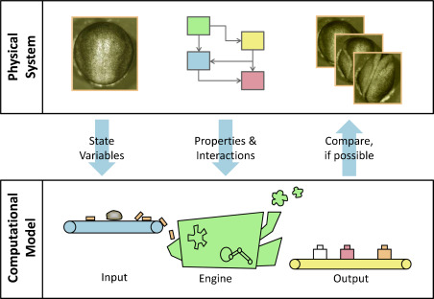
What are we trying to do?
Notes:
Reciprocal relationship between wet and dry in order to drive research

Slide 4
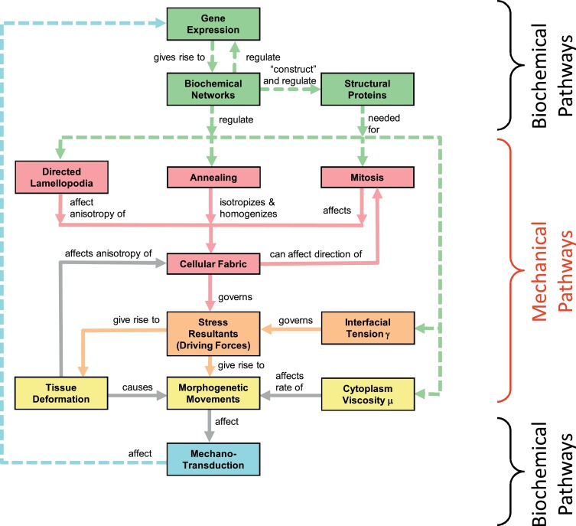
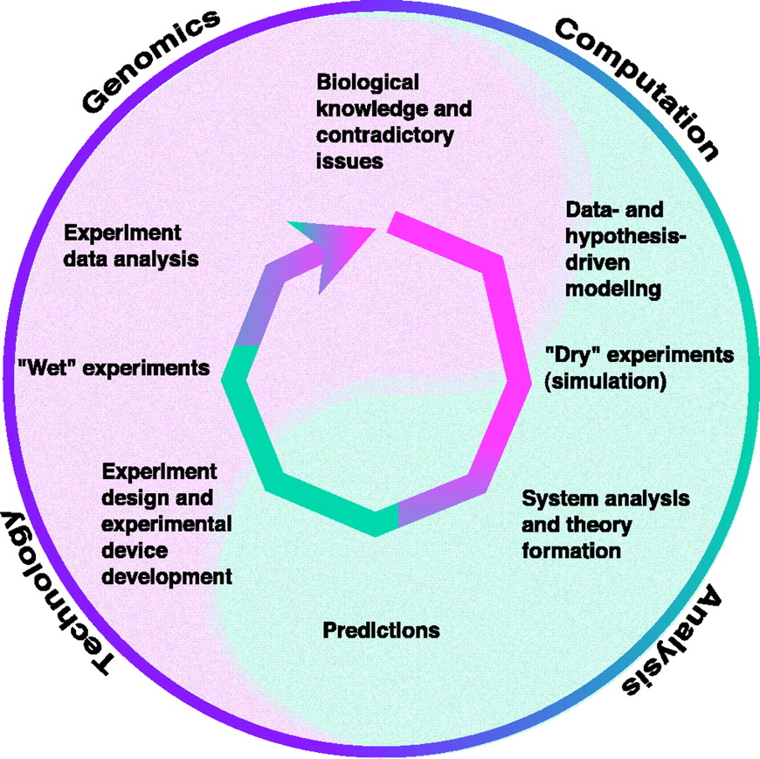
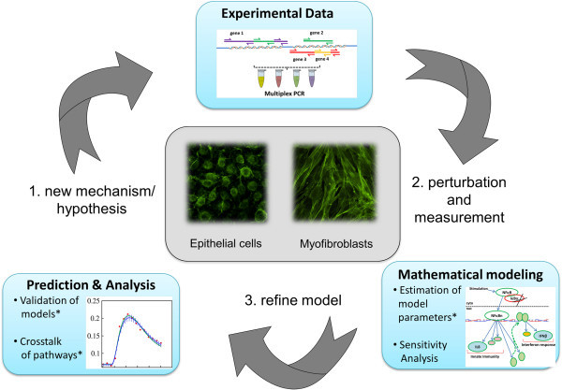
Notes:
Simulations are done by repeated perturbations and measurements. This can lead to refinements of the model.
Through this, behaviors can be found which can even lead to the development of clear mathematical governing equations. And you could go the other way too, by having equations to simulate behaviors.
Many parts of these systems are not linear.

Slide 5
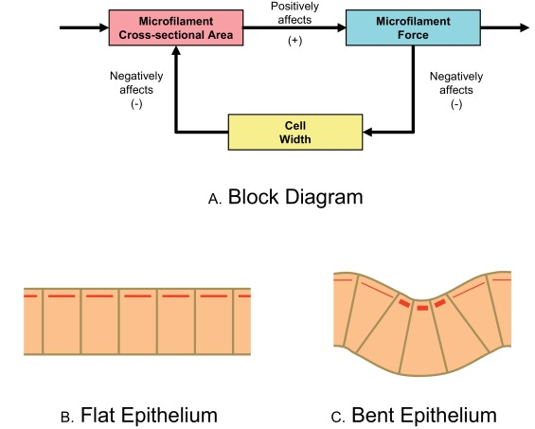
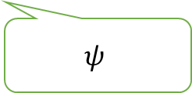
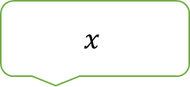
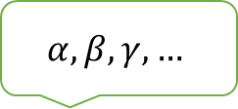
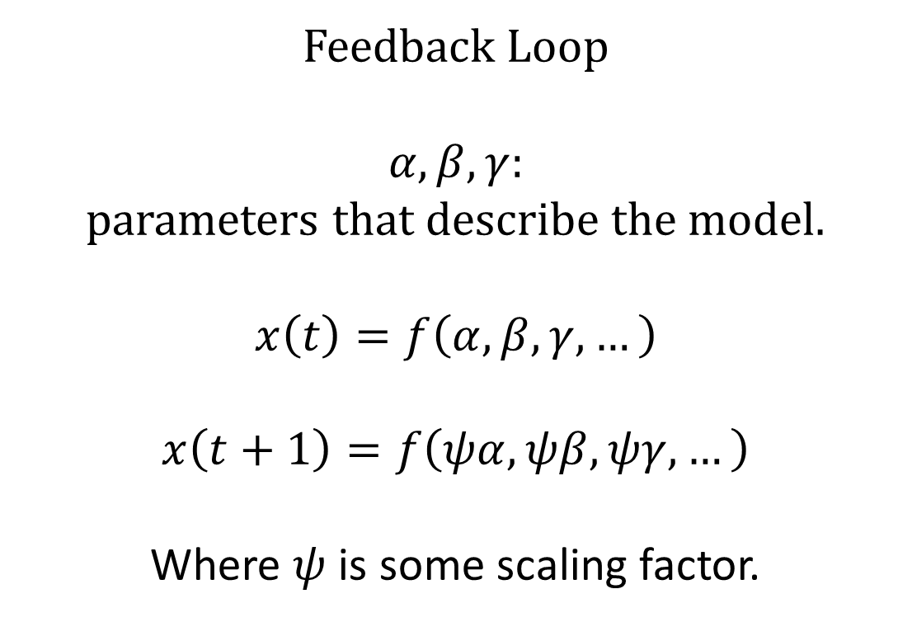
$$α,β,γ,…$$
$$x$$
Feedback Loop
$$α,β,γ:$$
parameters that describe the model.
$$x\left(t\right)=f\left(α,β,γ,…\right)$$
$$x\left(t+1\right)=f\left(ψα,ψβ,ψγ,…\right)$$
Where $ψ$ is some scaling factor.
$$ψ$$
Notes:
Complex systems can include behavior that is time-dependent and complex. A fundamental component of systems is the feedback loop, or the control loop.
Feedback loop: Use information from the current function output to adjust the function’s parameters for the next time step.

Slide 6
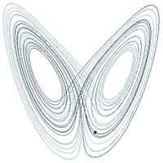
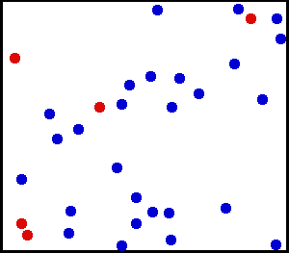
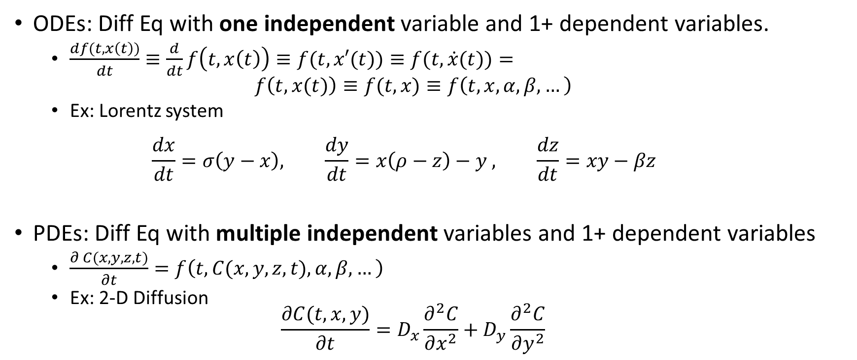
MATH
Diff Eq Youtube Video: https://youtu.be/-N8J9R6_oqY
ODEs: Diff Eq with one independent variable and 1+ dependent variables.
$\frac{df(t,x\left(t\right))}{dt}≡\frac{d}{dt}f\left(t,x\left(t\right)\right)≡f(t,x′(t))≡f(t,\dot{x}(t))=$ $f\left(t,x(t)\right)≡f(t,x)≡f\left(t, x,α,β,…\right)$
Ex: Lorentz system $\frac{dx}{dt}=σ\left(y−x\right), \frac{dy}{dt}=x\left(ρ−z\right)−y , \frac{dz}{dt}=xy−βz$
PDEs: Diff Eq with multiple independent variables and 1+ dependent variables
$\frac{∂ C(x,y,z,t)}{∂t}=f\left(t, C(x,y, z,t),α,β,…\right)$
Ex: 2-D Diffusion $\frac{∂C(t,x,y)}{∂t}=D_{x}\frac{∂^{2}C}{∂x^{2}}+D_{y}\frac{∂^{2}C}{∂y^{2}}$

Slide 7
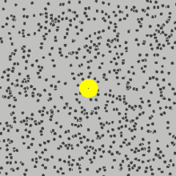
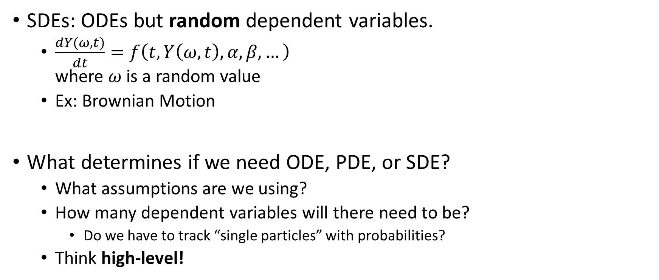
SDEs: ODEs but random dependent variables.
$\frac{dY(ω,t)}{dt}=f\left(t, Y\left(ω,t\right), α,β,…\right)$ where $ω$ is a random value
Ex: Brownian Motion
What determines if we need ODE, PDE, or SDE?
What assumptions are we using?
How many dependent variables will there need to be?
Do we have to track “single particles” with probabilities?
Think high-level!

Slide 8
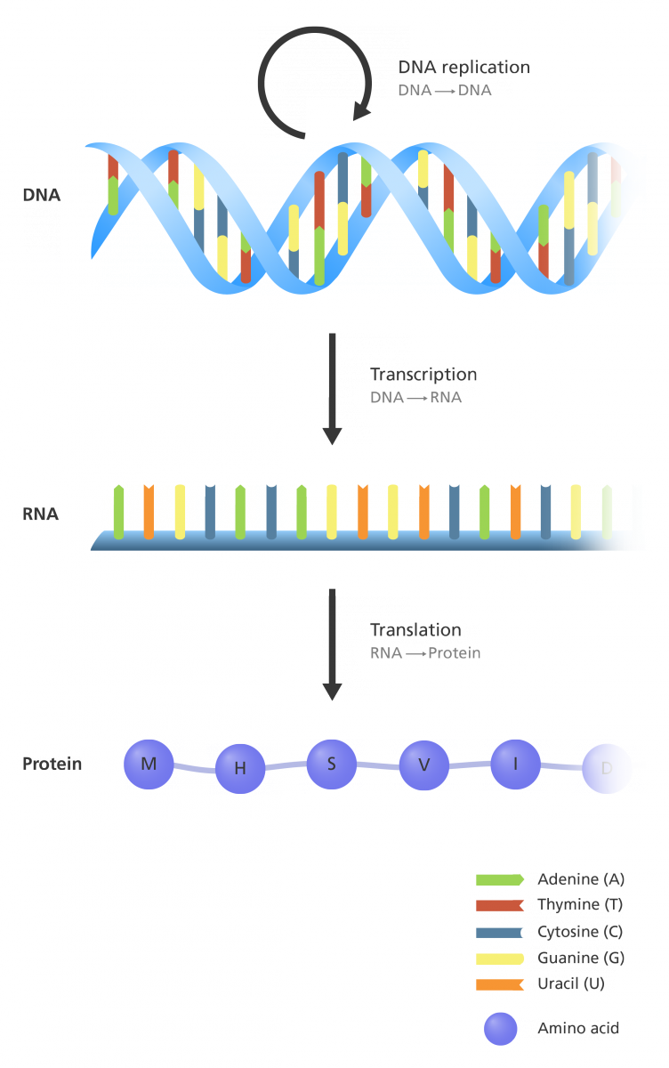


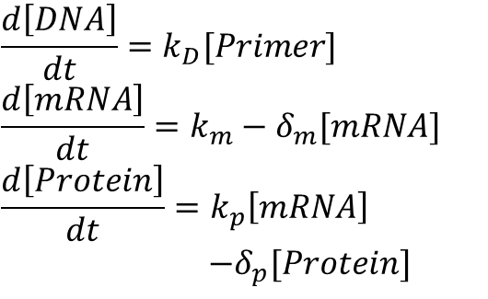
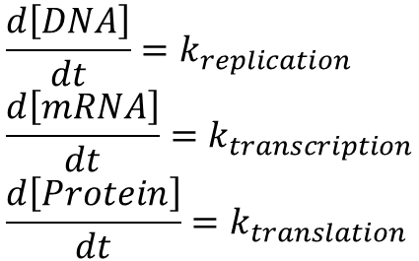
Verification vs. Validation
DNA –replication-> DNA
DNA –transcription-> mRNA
mRNA –translation-> Protein
VERIFI CATION
VALID ATION
$$\frac{d\left[DNA\right]}{dt}=k_{replication} \\ \frac{d\left[mRNA\right]}{dt}=k_{transcription} \\ \frac{d\left[Protein\right]}{dt}=k_{translation}$$
$$\frac{d\left[DNA\right]}{dt}=k_{D}[Primer] \\ \frac{d\left[mRNA\right]}{dt}=k_{m}−δ_{m}[mRNA] \\ \frac{d\left[Protein\right]}{dt}=k_{p}\left[mRNA\right]$$ $−δ_{p}[Protein]$
Notes:
A model is never perfect: Assumptions exist. Verification: Mathematical correctness -> The model is calculated correctly given assumptions made. Were the assumptions translated correctly to equations, equations were combined or simplified correctly, and model was solved correctly. Verifications are like a type of control. Validation: Ability to capture the real system. Do the assumptions match experimental data? You can: - Show the model reproduces a known behavior - Determine the parameters that works for the model and compare to the real system - Predict from the model a behavior, and test if it is true in the real system. If the model can predict something that was not used in the process of building the model, it is a strong validation.
Value must be added by a model in order to be useful. Proper verification and strong validation leads to a useful model. The model might allow us to confirm or test an unknown hypothesis. Or it may help design something.

